Slide 1
Dijkstra’s Algorithm
Presented By :- Snehal Tawar

Slide 2
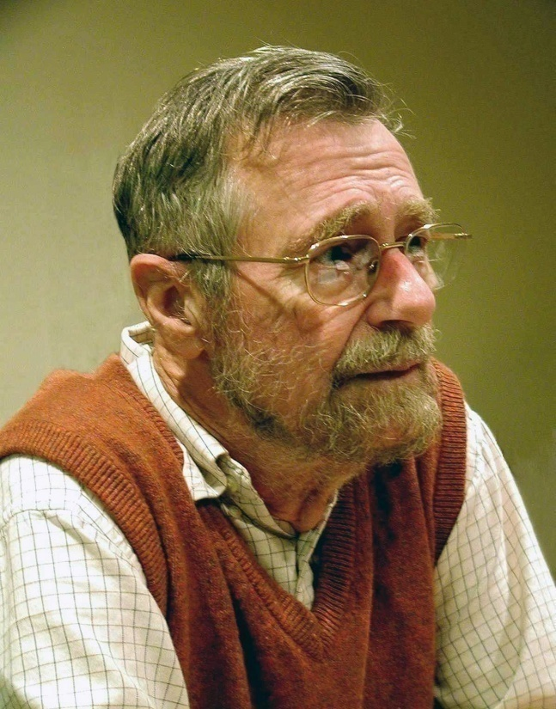
Dijkstra's Algorithm derived from a Dutch computer scientist ‘Edsger Wybe Dijkstra’ in 1956 and published in 1959. Dijkstra's algorithm - is a solution to the single-source shortest path problem in graph theory. Works on both directed and undirected graphs. However, all edges must have nonnegative weights. Approach: Greedy Input: Weighted graph G={E,V} and source vertex, such that all edge weights are nonnegative Output: Lengths of shortest paths (or the shortest paths themselves) from a given source vertex to all other vertices

Slide 3
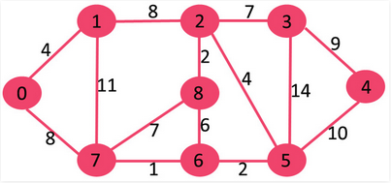
How it works? This algorithm finds the path with lowest cost (i.e. the shortest path) between that vertex and every other vertex. For example, if the vertices of the graph represent cities and edge path costs represent driving distances between pairs of cities connected by a direct road, Dijkstra's algorithm can be used to find the shortest route between one city and all other cities. Formula : O(|V|²+|E|) = O(|V|²) Where, E= Edges, V= Vertices |E| = Function of Edges |V| = Function of Vertices and O = Constant Graph Algorithm:

Slide 4

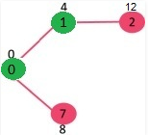
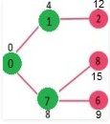
1) Pick the vertex with minimum distance value and not already visited. Set now becomes {0, 1}. Update the distance values of adjacent vertices of 1. The distance value of vertex 2 becomes 12. 2) Pick the vertex with minimum distance value and not already visited. Vertex 7 is picked. So Set now becomes {0, 1, 7}. Update the distance values of adjacent vertices of 7. The distance value of vertex 6 and 8 becomes finite (15 and 9 respectively). 3) Pick the vertex with minimum distance value and not already visited. Vertex 7 is picked. So Set now becomes {0, 1, 7}. Update the distance values of adjacent vertices of 7. The distance value of vertex 6 and 8 becomes finite (15 and 9 respectively).

Slide 5
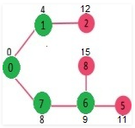
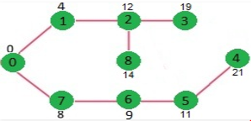
4) Pick the vertex with minimum distance value and not already visited. Vertex 6 is picked. So Set now becomes {0, 1, 7, 6}. Update the distance values of adjacent vertices of 6. The distance value of vertex 5 and 8 are updated. 5) We repeat the above steps until Set does include all vertices of given graph. Finally, we get the following Shortest Path Tree (SPT).
Implementation and Run Time:
The simplest implementation is to store vertices in an Array
or Linked list. This will produce a running time of
O(|V|^2 + |E|)
For graphs with very few edges and many nodes, it can be implemented more efficiently storing the graph in an adjacency list using a Binary Heap or Priority Queue. This will produce a running time of
O((|E|+|V|) log |V|)

Slide 6


Applications:
1) Traffic Information Systems are most prominent use - Mapping (Map Quest, Google Maps)
2) Routing Systems
References:
1) E. W. Dijkstra. (1959) A Note on Two Problems in Connection with Graphs. Numerische Mathematik, 1. 269-271
2) wikipedia.org
3) https://www.geeksforgeeks.org/
Thank You !

